Slide 1
Chapter 6 Decision Tree Learning

Slide 2
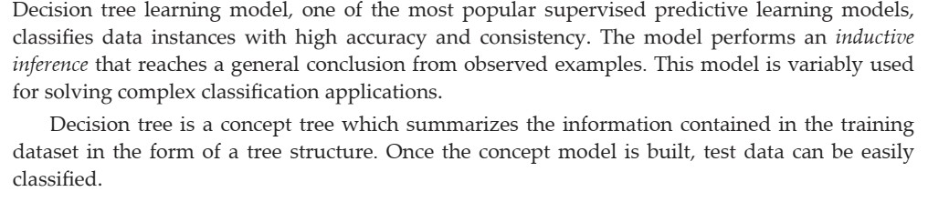
Decision Tree Learning Model

Slide 3
1.Model will classify both categorical and continuous valued target variables.
2.For a given training set X, hypothesis function f(X)as a decision tree.
3.The Decision tree generated a complete hypothesis space as a tree and allow us to search through the possible set of hypothesis.

Slide 4
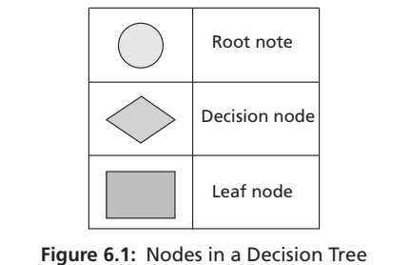
Structure of a Decision Tree

Slide 5
1.It is a structure with root node ,internal node/decision nodes, branches and leaf nodes. 2.Topmost tree node is root node
3.Internal nodes are test nodes and also decision nodes
4.These nodes represent a choice or test an input attribute and the outputs for a test condition.
5.The branches are labelled as per the outcomes or output values of the test condition.
6.Each decision is a path to a leaf node .
7.The leaf nodes represent the label or outcomes of a decision path.
8.Every path from root to leaf node represents the logical rule corresponds to a conjunction of test attributes and the whole tree represents the disjunction of these conjunctions

Slide 6
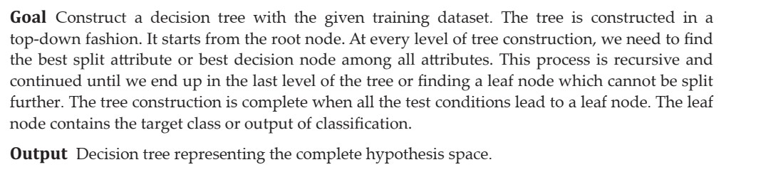
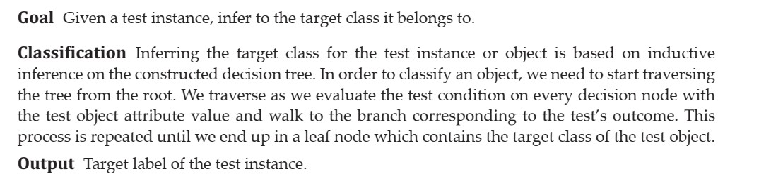
Structure of a Decision Tree
BUILDING THE TREE
KNOWLEDGE INFERENCE OR CLASSIFICATION

Slide 7
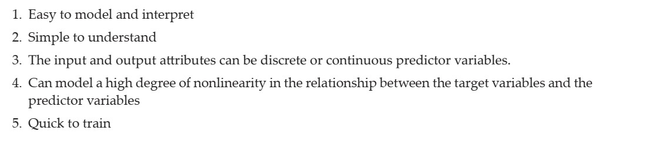
Advantages of Decision Trees

Slide 8
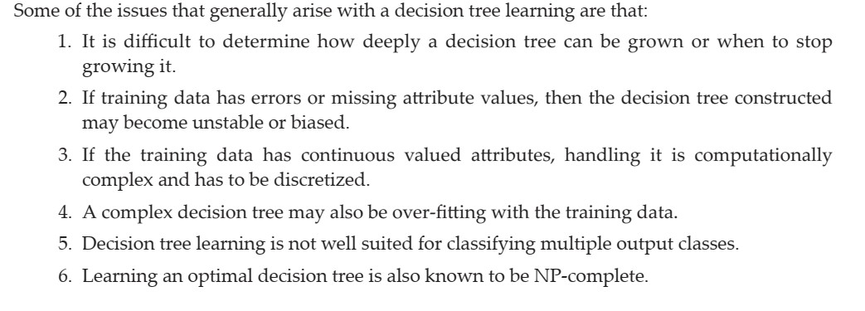
Disadvantages of Decision Trees

Slide 11
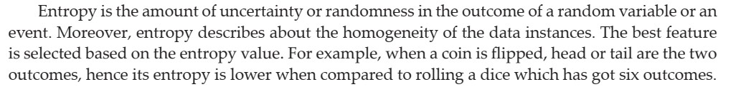
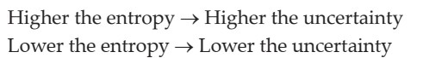
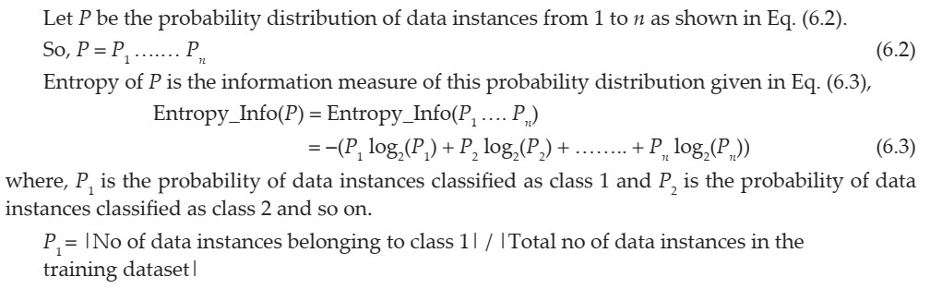
Fundamentals of Entropy

Slide 12
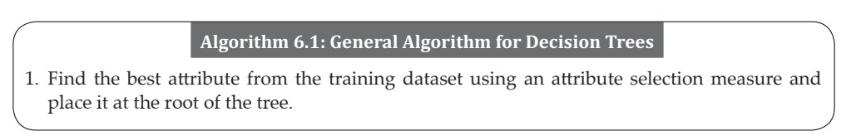
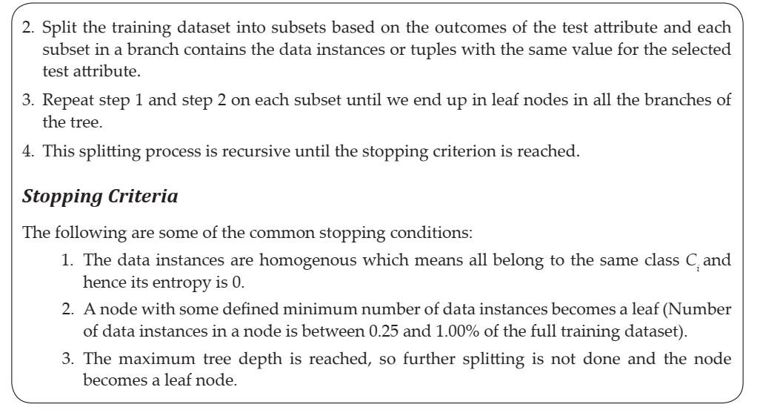
General Algorithm for Decision Trees

Slide 13
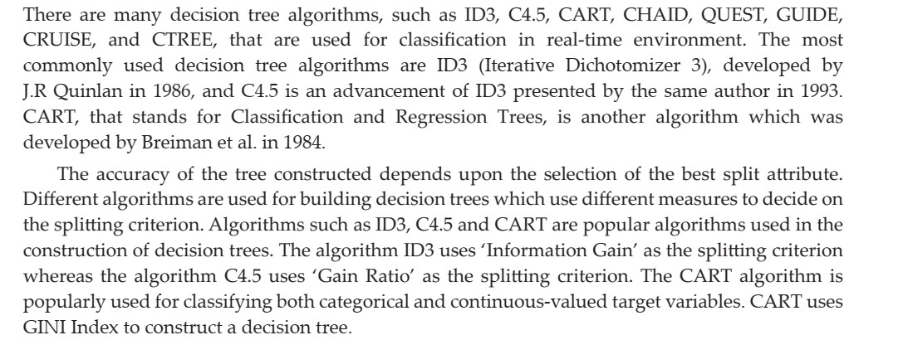
Decision Tree Induction Algorithms

Slide 14
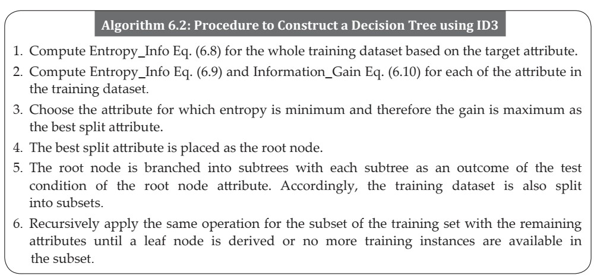
ID3 Tree Construction
1.ID3 is an example of univariate decision tree with only one feature at each decision node →axis aligned splits.
2.It constructs the tree using greedy approach in a top down fashion by identifying the best attribute of each level in the tree.
3.Works fine for discrete, otherwise it has to partitioned attributes to discrete features

Slide 15
The algorithm builds a tree using pruning measure “information Gain” with given training dataset and constructed tree to classify test data.
Works fine for larger dataset.
Small dataset overfitting
Not accurate if missing values.
C4.5 and CART handle discrete and continuous values
. C4.5 and CART handle missing data as well.
C4.5 is prone to outliers and CART handle it well.

Slide 23
C4.5 Construction
1.Works with missing values by marking ‘?’
2.Buids C5.0
3.Occam’s Razor problem ,two correct solutions, the simple one is chosen.
4.Need larger dataset for accuracy .
5.Uses gain ration as a measure during the construction of decision tree.

Slide 24
